Slide 1

SMART HEALTH MONITORING & ALERT SYSTEM USING IOT
Presentation on Project by Naveen Singh
Department of Computer Science & Engineering
AKS University, Satna (M.P.)

Slide 2


The Challenge
Modern lifestyles, chronic illnesses, and limited access to medical facilities in rural areas create significant healthcare gaps.
Without continuous monitoring, critical vitals like heart rate and oxygen levels can fluctuate unnoticed, leading to delayed medical responses and preventable emergencies.

Slide 3

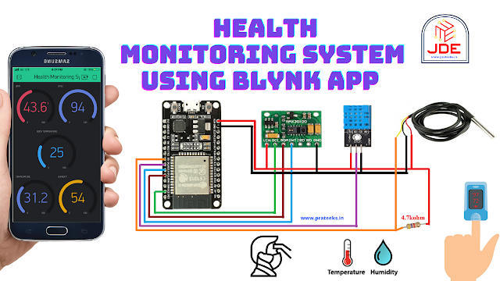
Proposed Solution
IoT-Based Architecture: A smart, low-cost system using NodeMCU ESP8266 to collect and transmit data wirelessly, bridging the gap between patients and doctors.
Real-Time Tracking: Unlike periodic checks, this system monitors SpO₂, Pulse Rate, and Temperature 24/7, making data instantly available on the cloud.

Slide 4






Key Objectives
Continuous Monitoring
Instant Alerts
Remote Access
To automatically trigger notifications via App/SMS when readings cross safe thresholds.
To enable doctors and caregivers to view patient data from anywhere via Cloud Dashboards.
To track vital signs (Heart Rate, SpO₂, Temp) continuously without manual intervention.

Slide 5


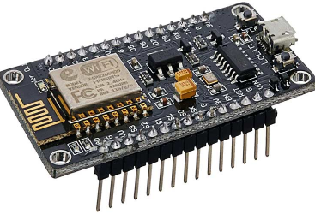

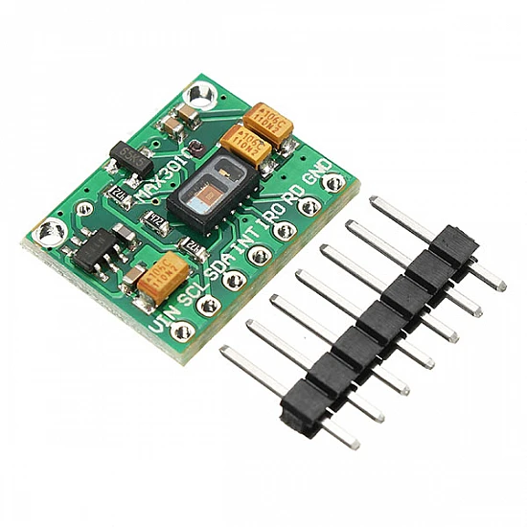


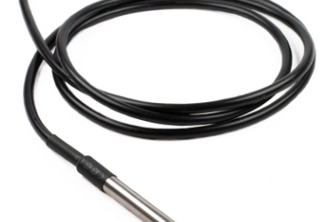
Core Hardware Components
NodeMCU ESP8266
MAX30102 (Pulse & SpO₂)
DS18B20 (Temperature)

Slide 6
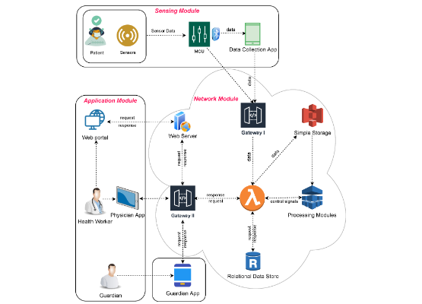
System Architecture
•
Sensing Layer: Biomedical sensors (MAX30102, DS18B20) collect raw analog/digital data from the patient.
•
Processing Layer: The NodeMCU processes signals, filters noise, and checks against safety thresholds.
•
Transmission: Data is encrypted and sent via Wi-Fi to the Cloud.
•
Application Layer: Blynk and ThingSpeak platforms visualize data and manage alerts.

Slide 7

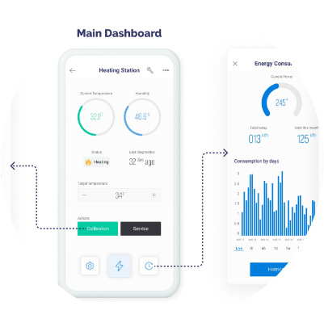
Software & Cloud Integration
Visualization & Control
The system leverages Blynk Cloud for real-time mobile visualization. Widgets display live Heart Rate, SpO₂, and Temperature data.
ThingSpeak is utilized for long-term data logging and trend analysis, allowing doctors to review historical patient data graphs.

Slide 8




Operational Workflow
Processing
Alerting
NodeMCU filters data
Notification if Abnormal
Data Collection
Cloud Upload
Sensors measure Vitals
Sent to Blynk/ThingSpeak

Slide 9



Project Impact
24/7
<2s
100%
Continuous Monitoring Capability
Latency for Emergency Alerts
Remote Access for Caregivers

Slide 10


Key Benefits
Early Detection: Identifies health deterioration before it becomes critical.
Reduced Hospitalization: Minimizes unnecessary hospital visits for routine checks.
User-Friendly: Simple mobile interface accessible to non-technical users.
Cost-Effective: Uses affordable components, making healthcare accessible to rural areas.

Slide 11


Future Scope
Expanding Capabilities
Future iterations can integrate AI & Machine Learning to predict heart anomalies before they occur.
Additional sensors for Blood Pressure and Glucose monitoring can be added to create a comprehensive "Hospital-in-a-Box" solution.

Slide 12

Thank You
Smart Health Monitoring & Alert System
Naveen Singh
B.Tech (CSE) - AKS University
Questions?

